Slide 1


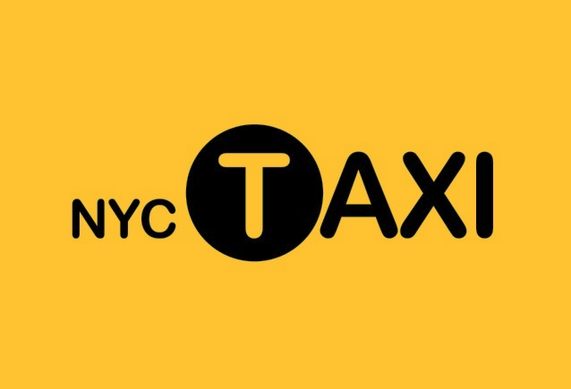
Yellow Cab NYC Taxi
Fare Prediction
Using LGBM and Keras Deep Learning algorithm
New York City Taxi Fare Prediction
Team 5
Yi Cai
Sameera Vattikuti
Nicholas Yang
Zeyu Zhu
Page Number 01

Slide 2
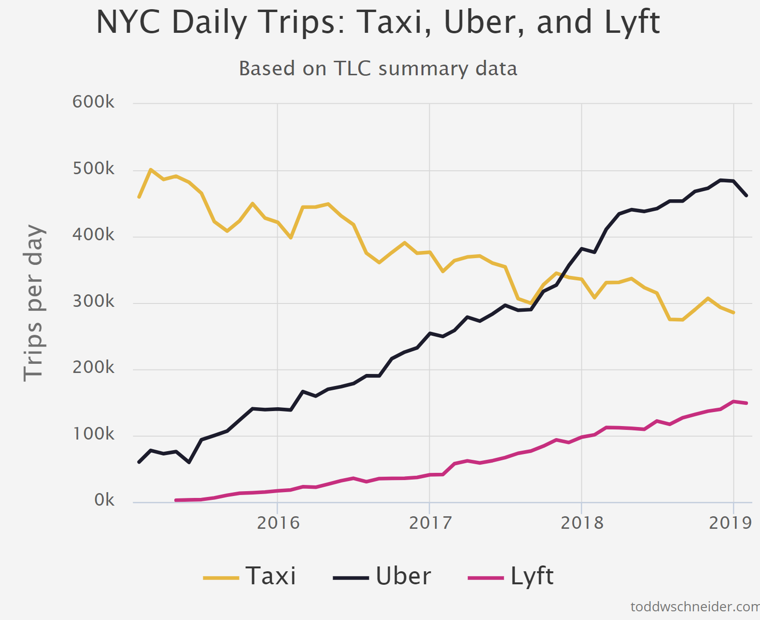
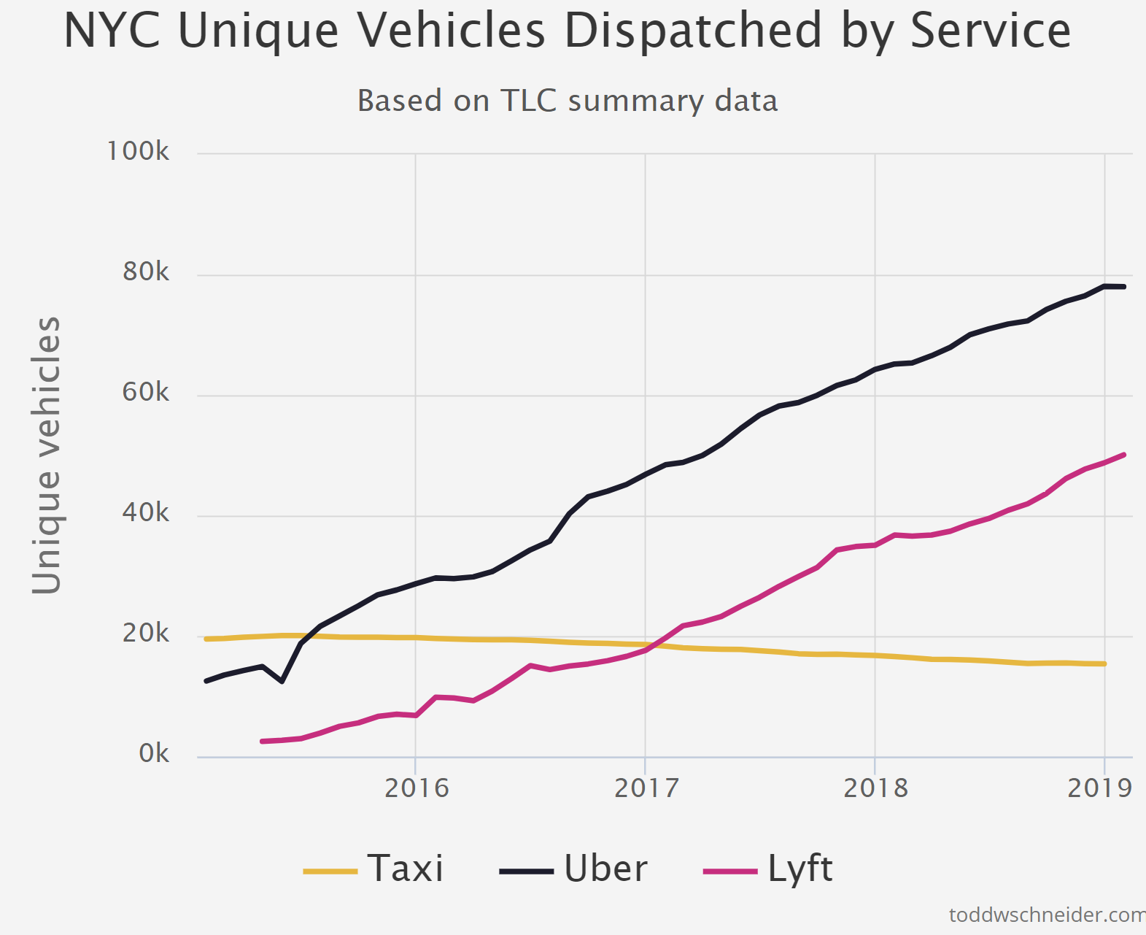
1
Business Background
NYC Taxi and its competitors
Ride-sharing companies like Uber and Lyft have changed the face of local commute.
While they add significant value to the customers, they have displaced a lot of traditional cab services in many cities - New York being one such major City.
Number of trips in app-based vehicles has increased from 6 million to 17 million a year, taxi trips have fallen from 11 million to 8.5 million*
The NYC Taxis are at a severe disadvantage in terms of access to technology and data.
*https://streeteasy.com/blog/how-many-taxis-in-nyc/
# https://toddwschneider.com/posts/taxi-uber-lyft-usage-new-york-city/
Page Number 03

Slide 3
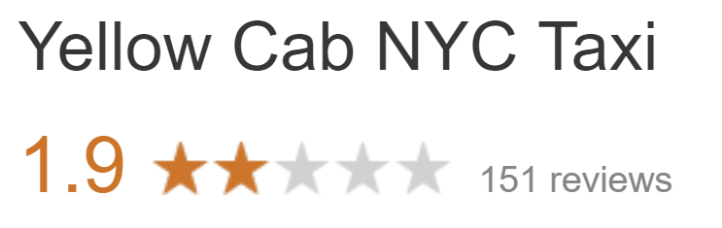

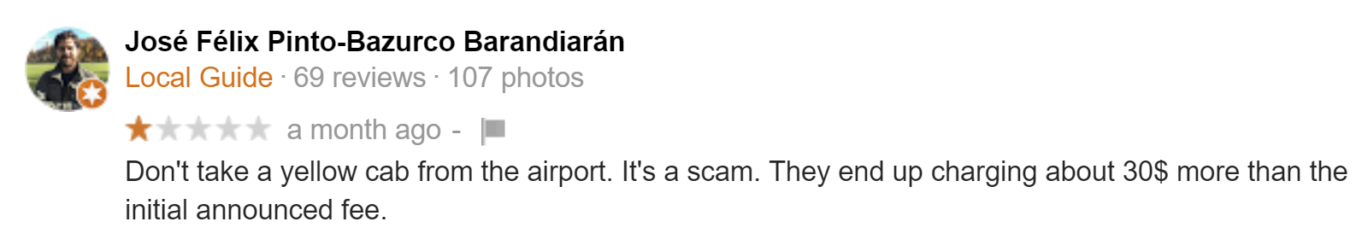
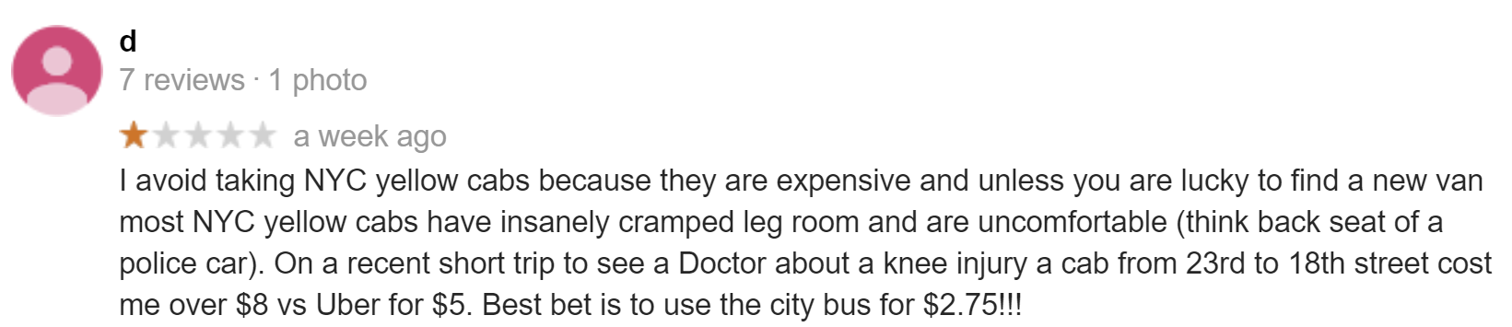
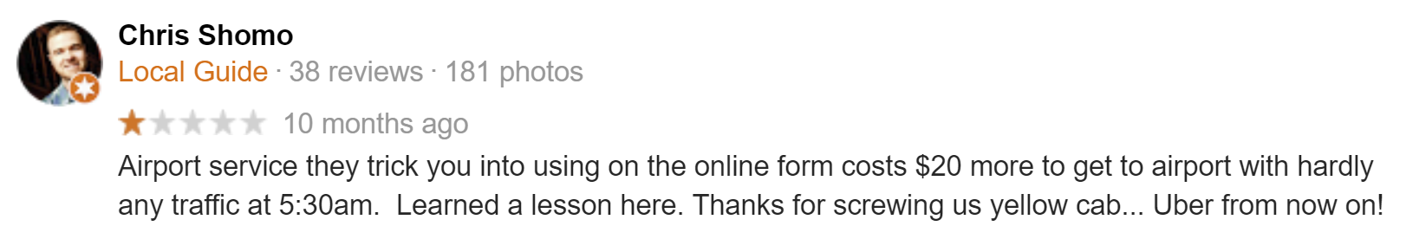
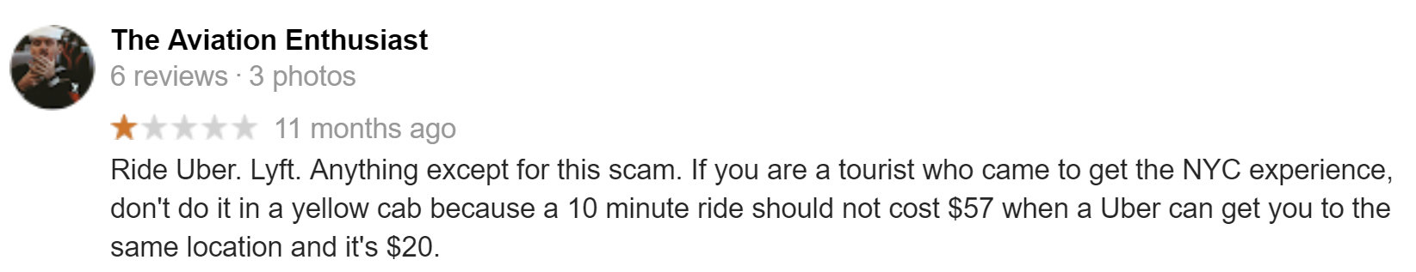

NYC Taxi Customer Feedback
Source: Google Reviews
Page Number 04

Slide 4
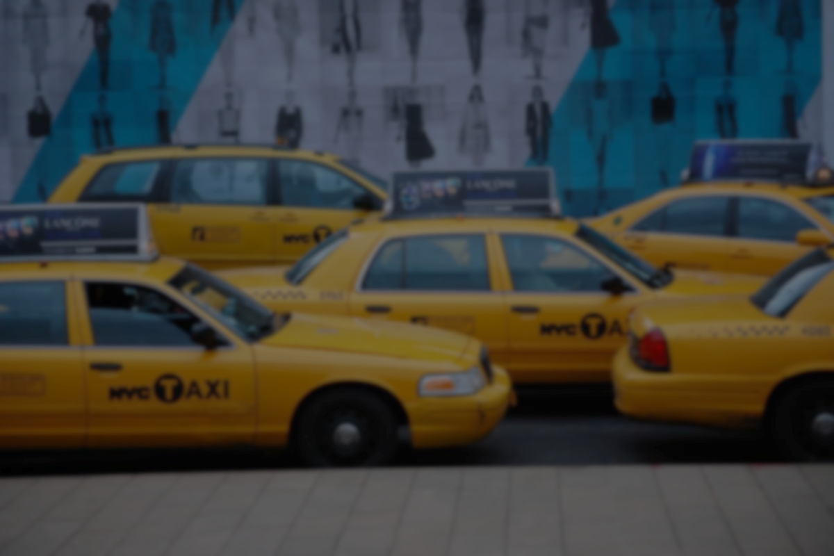
Problem Statement
Problem Statement
Objective: Increase Fare Transparency
Predict fare for a trip by NYC Taxi based on distance and time while considering factors like location, traffic, weather which could impact the length of the trip
Notes:
When a customer call in advance for an NYC taxi, they don't have information about how much a trip could cost. On the other hand, if they use a ridesharing service this is information is readily available to them. Hence fare transparency as a feature would add a lot of value to potential consumers of NYC Taxi and increase the usability of their service

Slide 5
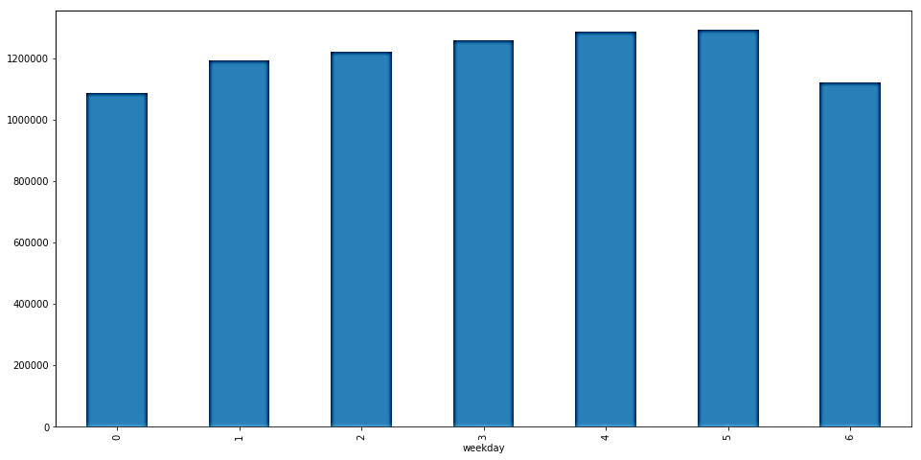
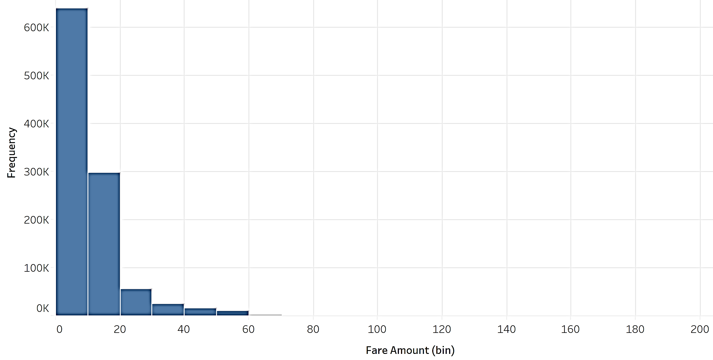
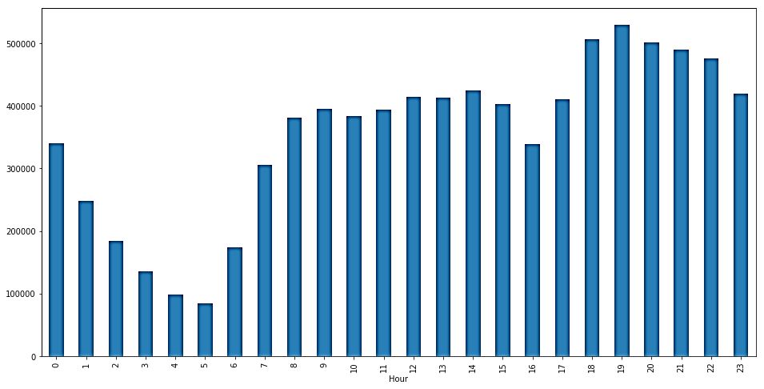
2
Data Exploration
55M+ Taxi fare records
Data Overview
New York Taxi Fare records on over 55M trips
8 Variables with information on fare amount, time, pick-up/drop-off longitude and latitude, passenger count
Fare Amount
Mean: 12.47 / Min: 2.51 / Max: 196.83
Passenger Count
Mean: 1.7 / Min: 1 / Max: 8
Rides
by weekday
Rides
by hours
Fare amount distribution
*https://www.kaggle.com/c/new-york-city-taxi-fare-prediction/data
Page Number 05

Slide 6

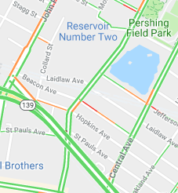



Combined with Data from other sources
Weather
Data
Hourly weather description data
Join on location, date and hour
Holiday
Data
Holiday list from 2012 to 2015
Join on date
Traffic Counts
Data
Hourly traffic volume from 5000+ traffic
observation spots
Join on location*, date and hour
Take average of the traffic counts that route might cover
Geo Data on
Airports & City center
Location data of airports and city center
Join on distance matrix
*https://www.kaggle.com/selfishgene/historical-hourly-weather-data
https://data.cityofnewyork.us/Transportation/Traffic-Volume-Counts-2012-2013-/p424-amsu
https://data.cityofnewyork.us/Transportation/Traffic-Volume-Counts-2014-2018-/ertz-hr4r
Page Number 06

Slide 7
Data cleaning and encoding
Filter
Distance matrix
Range: New York city and adjacent airports
Fare: $2.5- $200
Year: after Sep 4th, 2012*
Number of passengers: 1-8
Use Haversine formula to calculate the distance between two locations
*The time new fare structure starts from
Transform
Geocoding
Convert the weather condition, month, weekday and hour into dummy variables
Call Google API to convert street names into longitude and latitude
20 M+ instances and 66 independent variables
Page Number 07

Slide 8
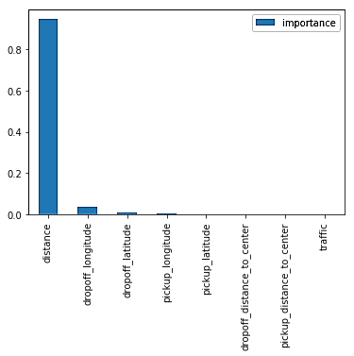
3
Modeling & Evaluation
Build 5 models and compare performance
Seen from importance score from random forest,
Distance is the variable that explains fare price best.
Lasso linear model
alpha = 0.0001
Random forest
max_leaf_nodes=80, max_depth=-1
Gradient boosting machine
nthread=4, num_leaves=80, learning_rate=0.05,
max_depth=-1, subsample=0.8, bagging_fraction=1,
max_bin=5000, bagging_freq=20, colsample_bytree
=0.8, num_rounds=8000
Stacking
linear model based on predictions from left 4 models
Keras neural networks
batch_size=128, epochs=40
4 layers with 66/22/4/1 nodes
Page Number 08

Slide 9
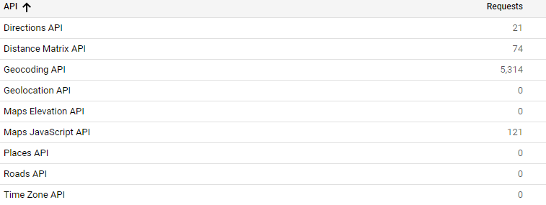

Model Evaluation
Gradient boosting decision trees turns out to be the best model
Result stands at Top 9% in the Kaggle competition
A good improvement from provided baseline model with RMSE of $5-$8
Next-steps:
Calculate distance by Google API
Add tolls location & price
RMSE on test
Gradient boosting machine:
2.97
Page Number 09

Slide 10


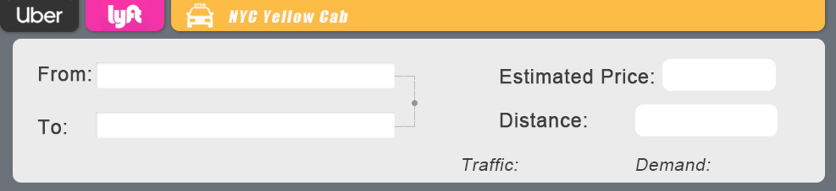
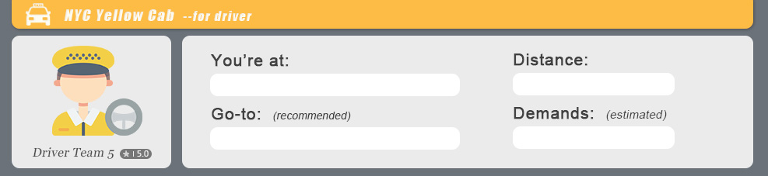
4
Application & Demo
Applications towards passengers and drivers
NYC Yellow Cab
For passenger
NYC Yellow Cab
For driver
Group 5 Technology Co. Ltd
Group 5 Technology Co. Ltd
Given current location, time, and user-input destination name, app displays:
Estimate fare price
Distance from real-time google map API
Estimate demands in nearby places
Estimate traffic condition during route
Given current location and time, app displays:
Recommended place to go
(based on dbscan spatial clustering)
Distance from real-time google map API
Estimate demands in recommended place

Slide 11
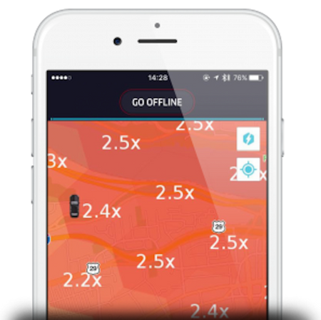
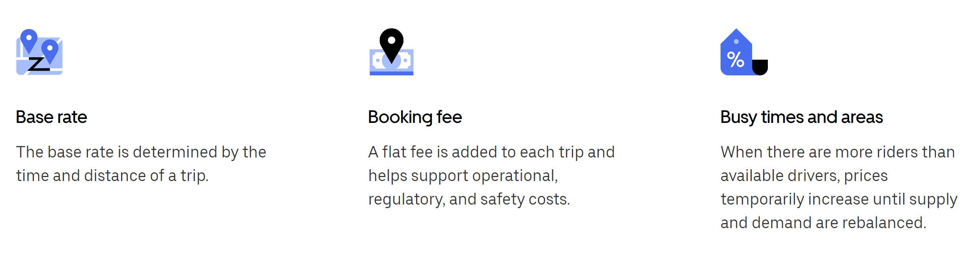
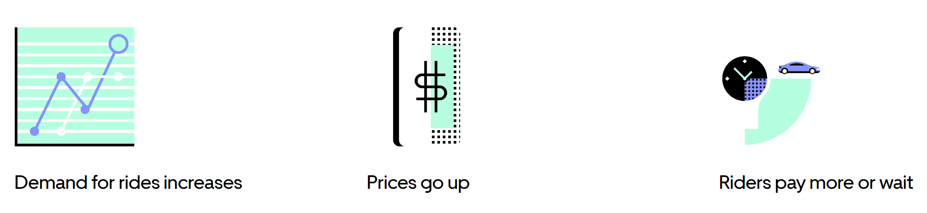
Existing Solutions
Consumer-Side
Driver-Side
Pricing
Surge Pricing
Source: Uber
Page Number 10
Notes:
Uber & Lyft use proprietary algorithms & not much is revealed about them. This is the information that they do share. Apart from this, there is also speculation that they hyper personalize pricing. Given the same data, 2 consumers may be charged completely different fares due to past history

Slide 12
5
Deployment & Insights
Deployment and next steps
Platform for Service Comparison
Price Estimation Error Under $3
Estimated Arrival Time
Traffic Info & Routes
Platform for Demand Prediction
Recommender System for Pick-up Locations based on Historical Demand & Destination Distance
PRICE
Market Cap from Uber/Lyft
15% Market Cap Gain
9% Revenue Gain
$197 million Business Value
CONVINIENCE
Route Optimization
Time Optimization
Live Traffic Monitoring
Customized Work Setting
SAFETY
En route Safety/ Tracking
Live location track
Route Approval
Complaint/Emergency
MARKET CAP
Shuttle Service
Inter-Zone Transportation
Page Number 11
Notes:
Since our models can be applied to better serve both sides of the taxi-ride, the deployment for such project is considered from both perspectives – driver and consumer. For consumers, we pictured such a model can be embedded in a service comparison platform, which can better provide customers a more detailed estimation of cost, ETAs, and routes among Taxi, Uber and Lyft. Currently, our model can provide a precise fare estimation with error under 3 dollars per trip. Also, one of the advantages of riding Taxi cabs, safety can be further improved with technology innovation as the platform for consumers will provide live location tracking and detouring alert. Thus, customers will have a more direct access to the authorities for complaints or emergency contact. Then Taxi will recover its lost market share and revenues from its competitors: Uber and Lyft. From year 2014 to 2018, Uber and Lyft took over 60% of whole market from Taxi and Rental Car industries. And taxi industries faced an annual revenue loss of 9%. By deploying our platforms, New York Taxi industries are predicted to increase their business value by 197 million dollars.
.For drivers, we intend to build a platform with demand prediction & recommendation. For example, drivers will be recommended to go to Times Square around 6:00PM as historical data may suggest that customer demand typically surges at that time. As we know, it is optimal for a yellow cab to get as many trips as possible. Thus, Integrating with both traffic and demand data, it is very promising that such platform can offer drivers the fastest route to the destination. Additionally, since yellow cab has a shift mechanism, drivers can set their personal preferences so the system will not recommend drivers to places where customers mainly demand to go to an opposite direction. As introduced previously, demand is represented by clusters in different zones. Hence, it is also very likely to extract common pattern in between different zones. Instead of specific location transportation, inter-zone shuttle services can be provided at certain location at certain time of a day for both driver and customer’s convenience.
For future steps, Taxi companies should refrain themselves using such model for price gouging, which means increase the price when demand goes up just like Uber and Lyft. Also, there are risks related to live traffic/demand data variates from historical data. Adopters should incorporate such real-time data to improve the performance of the model, such as event and weather data.

Slide 13

Thank you!
Questions?
New York City Taxi Fare Prediction

